Slide 1
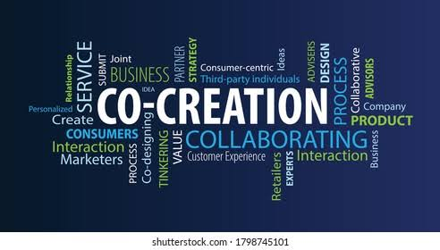

CO – CREATION AND PRODUCT DESIGN
Dr. S. VIJAYA BHASKAR
M.Tech (Mech)., Ph.D (Mech)., Ph.D (Management)
Professor in Mechanical Engineering
Sreenidhi Institute of Science and Technology
Yamnampet, Ghatkesar, Hyderabad, Telangana-501301

Slide 2
CO – CREATION AND PRODUCT DESIGN CO – CREATION AND PRODUCT DESIGN CO – CREATION AND PRODUCT DESIGN CO – CREATION AND PRODUCT DESIGN CCO – CREATION AND PRODUCT DESIGN
Unit – I: Human Centered
Contents:
Understanding User and Customer
Perspectives,
Identify insights and opportunities,
Interviewing,
User Experience design.
Frame your design challenge.
Empathy tools and techniques.

Slide 3
Understanding User and Customer Perspectives
For any organization, people are important (Users and/or Customers)
A customer is the individual or organization that pays for a product, while a user is the person who physically interacts with it.
In retail (B2C), they are often the same, but in B2B or specialized fields, the buyer and the consumer are completely different.

Slide 4
Understanding User and Customer Perspectives
Who is a User? Who is a Customer?
User
Uses the product or service
Experiences its benefits and challenges
Provides feedback for improvement
Customer
Purchases or pays for the product
Makes buying decisions
Expects value for money (ROI)
Example: SNIST ERP System (performance.sap.com)
Customer: College Management
Users: Teachers, Students, Parents

Slide 5
Understanding User and Customer Perspectives
Why Understanding Users & Customers Matters
Successful entrepreneurs understand:
Customer needs
User expectations
Pain points
Buying behavior
Product experience
Understanding both perspectives leads to better products and successful businesses.
Entrepreneurship starts with solving real customer problems, not just creating products.

Slide 6
The User Perspective
The user is the end-consumer focused on how the product functions in their day-to-day life or job.
Primary Concerns: Usability, efficiency, stability, intuitiveness, and how well the product fixes a specific task or pain point.
Goal: They want to achieve their tasks as quickly and seamlessly as possible.
Measurement: Success is measured through UX metrics like task completion rates, time-on-task, and error rates

Slide 7
The Customer Perspective
The customer is the decision-maker focused on the business case, purchasing criteria, and the overall value provided by a product or service. [1, 2]
Primary Concerns: Cost-effectiveness, return on investment (ROI), strategic benefits, vendor reputation, and scalability.
Goal: They want to know the product will solve a team's problem at a justifiable price point.
Measurement: Success is tied to Key Performance Indicators (KPIs) like customer retention, lifetime value, and Net Promoter Score (NPS).

Slide 8
Understanding User and Customer Perspectives
Why Understanding Users is Important
Entrepreneurs should know:
What users need
What frustrates them
What makes their work easier
What features they value
Ignoring users leads to poor adoption.
Example
A software with many features but difficult navigation may fail because users cannot operate it easily.

Slide 9
Understanding User and Customer Perspectives
Why Understanding Customers is Important
Customers ask questions like:
Is it affordable?
Is it reliable?
Will it save money?
Is customer support available?
Is it worth buying?
Entrepreneurs must answer the above questions clearly.

Slide 10
Understanding User and Customer Perspectives
Methods to Understand Users and Customers
Simple Research Methods
👀 Observation
🎤 Interviews
📋 Surveys
👥 Focus Groups
⭐ Customer Feedback
Empathy helps entrepreneurs understand what customers think, feel, and need.

Slide 11
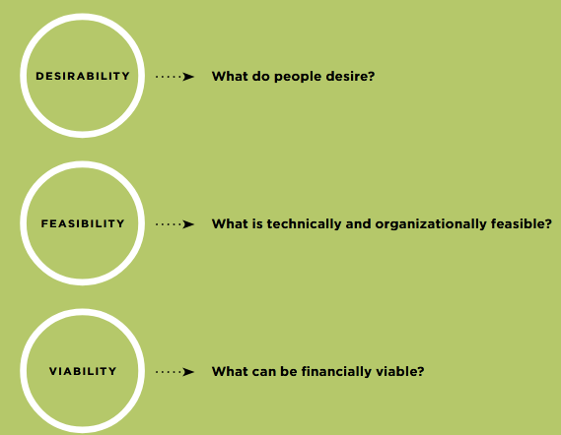
Understanding User and Customer Perspectives
Human-Centered Design (HCD) is a process and a set of techniques used to create new solutions for the world.
Solutions include products, services, environments, organizations, and modes of interaction.
The reason this process is called “human-centered” is because it starts with the people we are designing for. The hCD process begins by examining the needs, dreams, and behaviors of the people we want to affect with our solutions.
THE THREE LENSES OF HUMAN-CENTERED DESIGN

Slide 12
Human-Centered Design
Human-centered design (HCD) is a qualitative research method (collecting and analyzing non-numerical data (like text, audio, or video) to understand concepts, opinions, and lived experiences) that helps groups to solve problems and seek solutions that prioritize customer needs over a system’s needs.
It’s also a design and management framework to develop solutions to problems by involving the human perspective in all steps of the problem-solving process.

Slide 13
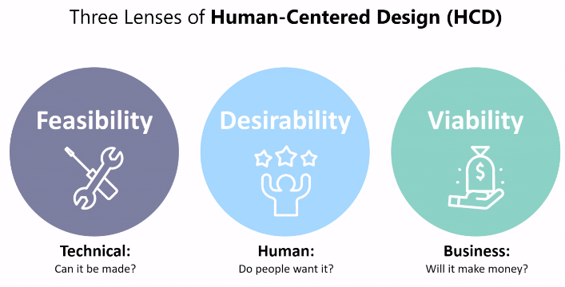
Human-Centered Design
Human-Centered Design (HCD) is a user-focused approach to problem-solving that puts people—along with their needs, experiences, and contexts—at the forefront of innovation.

Slide 14
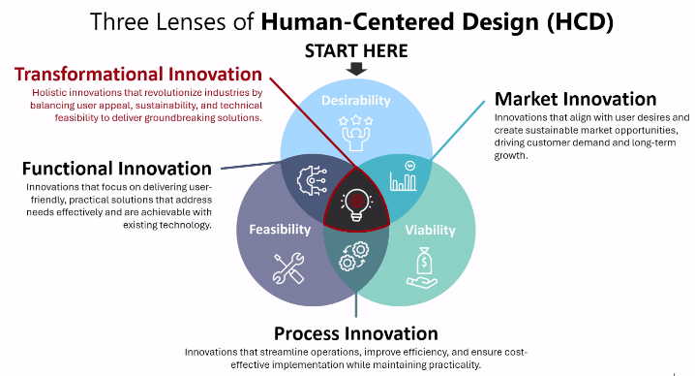
Human-Centered Design

Slide 15
Human-Centered Design
1. Desirability:
Desirability focuses on the human aspect—what people want and need. It ensures that a solution resonates emotionally, functionally, and culturally with users.
Questions this lens addresses include:
What problems are users facing?
How can this solution improve their lives?
Does it create an engaging and meaningful experience?
For instance, designing a health-tracking wearable isn’t just about functionality; it’s about motivating users through intuitive interfaces and insights that empower them.

Slide 16
Human-Centered Design
2. Feasibility:
Feasibility is all about practicality—ensuring the solution can be realized with existing or emerging technology. This lens evaluates technical and operational constraints.
It explores questions such as:
Is the solution technically achievable with current resources?
Do we have the expertise, tools, and infrastructure to implement it?
Can it scale to meet user demand?
Take autonomous vehicles as an example: While the idea is desirable and viable, feasibility depends on advancements in AI, infrastructure, and safety systems.

Slide 17
Human-Centered Design
3. Viability:
Viability ensures that the solution is sustainable in the real world. This lens focuses on the business, environmental, and societal implications of the design.
Key questions include:
Is the solution financially sustainable?
Does it align with organizational goals and environmental values?
Can it succeed long-term without harming the planet or society?
For example, a renewable energy system might be highly desirable and feasible, but its viability depends on cost-effectiveness and scalability to serve diverse markets.

Slide 18
Understanding User and Customer Perspectives
Human-centered design is a creative approach to solve problems
Human-Centered Design (HCD) is often structured as a practical three-phase acronym: Hear, Create, and Deliver
Hear (Inspiration): You step out into the field to listen to the people you are designing for. Using ethnographic research, interviews, and observations, you gather stories and understand the true needs and pain points of the end user.
Create (Ideation): You translate the data you've gathered into actionable themes. Multidisciplinary teams, brainstorm, and build rapid, low-fidelity prototypes to test assumptions, visualize ideas, and refine solutions alongside the users.
Deliver (Implementation): You bring your solution to life. This phase involves creating a pilot, building a viable business or operational model, launching the product into the real world, and iterating based on ongoing user feedback.

Slide 19
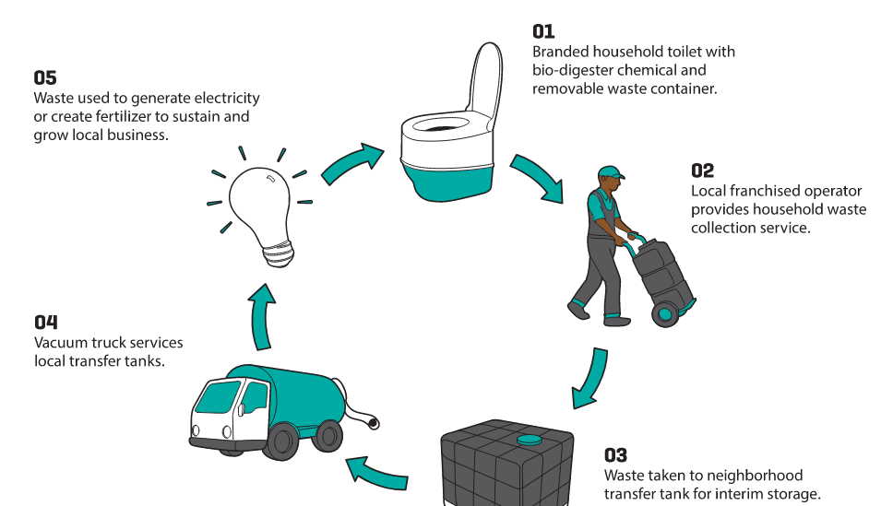
Understanding User and Customer Perspectives

Slide 20
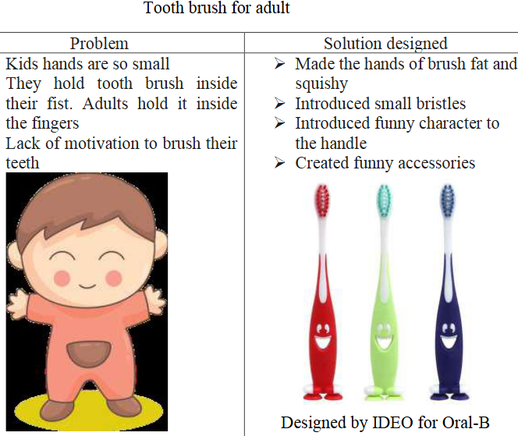

Winning Companies Use Human Centered Design

Slide 21
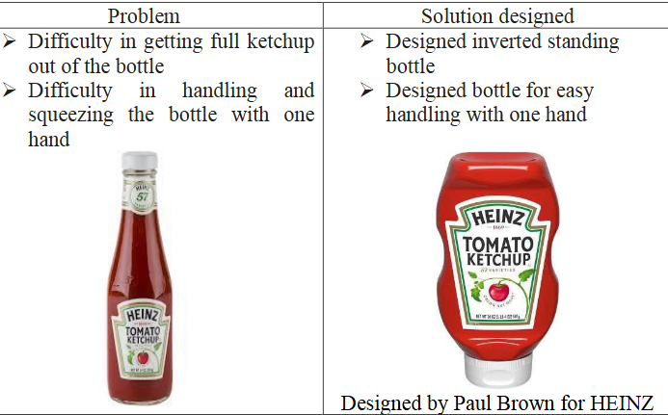
Winning Companies Use Human Centered Design

Slide 22
Identify Insights And Opportunities
Entrepreneurship begins with identifying an opportunity. Successful entrepreneurs do not merely create products; they discover unmet needs, solve problems, and create value for customers.
Definition of Insight
An insight is a deep understanding of customer behavior, needs, problems, desires, or market trends that can lead to a business idea.
Definition of Opportunity
An opportunity is a favorable set of circumstances that creates a need for a new product, service, or business venture.
Example
Insight: People dislike waiting in long queues for food.
Opportunity: Develop a food delivery app that delivers meals quickly.

Slide 23
Identify Insights and Opportunities
Importance of Identifying Insights
Understand Customer Needs – Helps entrepreneurs discover what customers truly want.
Identify Business Opportunities – Reveals unmet needs and market gaps.
Solve Real Problems – Leads to innovative products and services that add value.
Reduce Business Risk – Decisions are based on customer insights rather than assumptions.
Gain Competitive Advantage – Helps businesses offer unique and differentiated solutions.
Support Better Decision-Making – Provides a strong foundation for product development and marketing.
Improve Customer Satisfaction – Businesses that meet customer expectations build loyalty and trust.
Drive Business Growth – Continuous insights help entrepreneurs innovate and adapt to changing markets.

Slide 24
Identify Insights And Opportunities
Importance of Identifying Opportunities
Entrepreneurs must identify opportunities because:
Markets constantly change.
Customer needs evolve.
Technology creates new possibilities.
Competition opens new gaps.
Economic and social changes generate new demands.
Quote
"Entrepreneurs see opportunities where others see problems."

Slide 25
Identify Insights And Opportunities
How to Identify Insight and Opportunities?
Common Methods
👀 Observe customer behavior
📊 Conduct market research
💡 Brainstorm ideas
🤝 Network with customers and experts
🌐 Monitor industry and technology trends

Slide 26
Identify Insights And Opportunities

Slide 27
Identify Insights And Opportunities
What is an Insight?
An insight is defined as the aspects and characteristics of consumer and customer behavior that are typically “hidden.”
Definition of Insight
An insight is a deep understanding of customer behavior, needs, problems, desires, or market trends that can lead to a business idea.
Definition of Opportunity
An opportunity is a favorable set of circumstances that creates a need for a new product, service, or business venture.
Example
Insight: People dislike waiting in long queues for food.
Opportunity: Develop a food delivery app that delivers meals quickly.

Slide 28
Identify Insights And Opportunities
Where Do Insights Come From?
Customer Databases: These can tell us the identity of our consumers, the nature of our relationship with them, their transactions, and the value of those transactions.
Internal Data: Various departments within a company can provide significant pieces of knowledge, such as employee interactions, operational constraints, financial implications, and customer complaints.
Market Data: Companies need an external perspective on market volume and value, their market share, and broader trends (consumer, demographic, economic, technological, etc.).
Consumer Research: Market research is the backbone of generating insights for many companies, whether quantitative, qualitative, ethnographic, semiotic, or through other methods. This involves talking to consumers to understand why they act the way they do and under what circumstances they might act differently.

Slide 29
Methods for Identifying Opportunities
A. Observation
Entrepreneurs carefully observe people, markets, and trends.
Questions to Ask
What frustrates customers?
What tasks are difficult?
What products are missing?
Example
Observing students carrying heavy books may lead to a digital note-sharing platform.

Slide 30
Identify Insights And Opportunities
B. Brainstorming
Generating multiple ideas without immediate criticism.
Steps
Identify a problem.
Generate many solutions.
Evaluate later.
Select the best idea.
Benefits
Encourages creativity.
Produces innovative ideas.

Slide 31
Identify Insights And Opportunities
C. Market Research
Systematic collection of information about customers and competitors.
Research Methods
Surveys
Interviews
Focus groups
Online research
Benefits
Reduces uncertainty.
Validates business ideas.

Slide 32
Identify Insights And Opportunities
D. Networking
Interacting with people often reveals opportunities.
Sources
Customers
Suppliers
Industry experts
Mentors
Entrepreneurs
Benefit
Access to information, ideas, and partnerships.

Slide 33
Identify Insights And Opportunities
Opportunity Area:
An opportunity area is a stepping stone to idea generation.
An opportunity is a rearticulating of problems or needs in a generative, future facing way.
An opportunity area is not a solution. Rather, it suggests more than one solution. It allows the team to create many solutions.
Framing opportunity Areas: Opportunities start with the phrase “How Might We...?” to suggest a mindset of possibility.
TIP – 1: Start each statement with “How Might We...?” and abbreviate on post-its to “HMW.”
TIP – 2: use different color post-its for your opportunity statements than you used for insights. This will help to visually separate insights from opportunities for the next step.

Slide 34
Cont…
TIP -3: Go for quantity, not quality at this point.
TIP – 4: When narrowing down the opportunity statements to 3-5 HMW statements to use in brainstorming, select some that are intentionally outside of your current projects or capabilities.
At this point, filter based on Desirability to customers, not Feasibility to the organization.
If your opportunity sounds like a specific solution, back it up by asking yourself, “Why would we want to offer this solution?” or “What user needs are answered by this solution?”

Slide 35
Cont…
An Example: Insight: Trust building and knowledge sharing happens through ‘seeing is believing.’
Solution: A training course offered by community members to teach their friends and neighbors about a technology or behavior that has worked for them. This is a solution. Ask yourself: What needs are answered by this solution?
Answer: The need to expand the knowledge of community members through local information aggregators. Opportunity: How might we better educate and inform local knowledge aggregators? Or how might we support new technology experimentation by local knowledge aggregators?

Slide 36
Interviewing
Design research is useful to not only understand individuals but also frame individual behaviors in the context and community that surrounds them.
Seven methods described here are:
Individual Interview
Group Interview
In Context Immersion
Self-Documentation
Community-Driven Discovery
Expert Interviews
Seeking Inspiration in new places

Slide 37
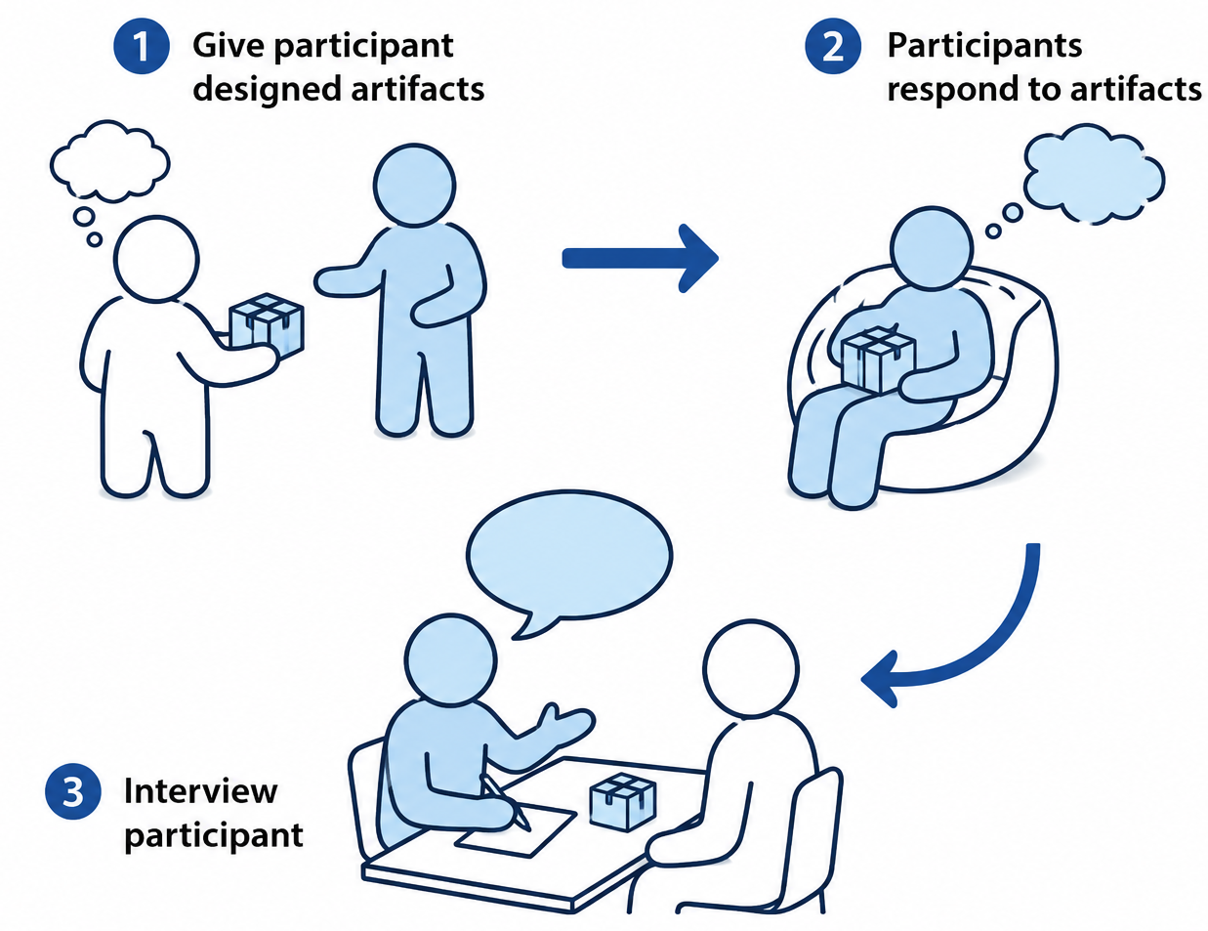
Interviewing
1. Individual Interview
Step – 1: The interview should be conducted without an audience, since the presence of neighbors, friends, or others can sway what the person says or what they are able to reveal.
Step – 2: Assign the following roles so that each person has a clear purpose visible to the participant: » one person to lead the interview » a note taker » a photographer

Slide 38
(Cont.…)
2. Group Interview
Group-based Interviews can be a valuable way to learn about a community quickly.
Group Interviews can be good for learning about community life and dynamics, understanding general community issues, and giving everyone in a community the chance to voice their views.
Note: Group Interviews are not good for gaining a deep understanding of individual income streams, uncovering what people really think, or understanding how to change commonly-held beliefs or behaviors

Slide 39
(Cont.…)
3. In Context Immersion
Meeting people where they live, work, and socialize and immersing yourself in their context reveals new insights and unexpected opportunities.
Putting yourself in someone’s shoes enables you to get beyond what people say to what they think and feel.
Being in-context means gaining true empathy through being with people in their real settings and doing the things they normally do.
what people say (and think) they do and what they actually do are not always the same thing.
The goal is not to correct or point out the misperception, but rather to understand the difference.

Slide 40
(Cont.…)
4. Self-Documentation
Self-Documentation is a powerful method for observing processes over a long period of time,
Recruit several people and give them cameras, video cameras, voice recorders or journals, with instructions.
Ask them to document their experiences over a few days or weeks.
Give participants instructions designed to guide them on how to easily record activities that will yield relevant information to the research project.
The easier it is to self-document, the more likely it is that participants will complete the exercise.

Slide 41
(Cont.…)
5. Community-Driven Discovery
Community members with strong relationships, respected leaders, or people with a reputation for intelligence and fairness are often good people to identify as research partners.
Experts can be called upon to provide in-depth and technical information.
Some examples of good times to call upon expert interviews are: » To learn about the history of a particular community or topic. » To understand the regulations that might affect design and implementation of solutions. » To gather information about new technologies that have been recently invented or that are on the horizon.

Slide 42
(Cont.…)
6. Expert Interview: Experts can be called upon to provide in-depth and technical information.
Some examples of good times to call upon expert interviews are: » To learn about the history of a particular community or topic » To understand the regulations that might affect design and implementation of solutions » To gather information about new technologies that have been recently invented or that are on the horizon

Slide 43
(Cont.…)
7. Seeking Inspiration in new places
One of the best ways to inspire new ideas is to look at similar experiences in other contexts, instead of focusing too narrowly on the research topic.
For example, a doctor’s visit might include the following activities and feelings: getting sick, discussing a doctor visit with family, travel, paying, and following doctor instructions such as taking medication or changing behavior.
Find other situations that include some or all of these activities and then go and observe them.

Slide 44
User Experience Design.
UX design refers to the term “user experience design”, while UI stands for “user interface design”. Both elements are crucial to a product and work closely together.
But despite their professional relationship, the roles themselves are quite different, referring to very different aspects of the product development process and the design discipline.
User experience design is a human-first way of designing products. Don Norman, a cognitive scientist and co-founder of the Nielsen Norman Group Design Consultancy, is credited with coining the term “user experience” in the late 1990s. Here’s how he describes it:
“User experience encompasses all aspects of the end-user’s interaction with the company, its services, and its products.”

Slide 45
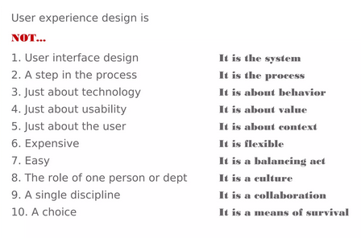
User Experience Design. (Cont..)

Slide 46
Frame Your Design Challenge
A Design Challenge is phrased in a human-centered way with a sense of possibility.
For example: “Create savings and investment products that are appropriate for people living in rural areas.”
The Design Challenge can be decided by organizational leadership or can be developed through a team-based approach.
A good Design Challenge should be:
Framed in human terms (rather than technology, product, or service functionality).
Broad enough to allow you to discover the areas of unexpected value.
Narrow enough to make the topic manageable.

Slide 47
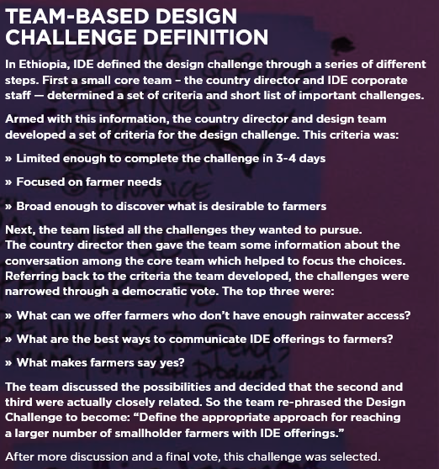
Frame Your Design Challenge

Slide 48
Frame Your Design Challenge
Step 1: Post the design challenge so that the team can see it.
Step 2: hand out post-it notes to the design team, and ask them to write what they already know about the topic. have one piece of information per post-it not
Step 3: Ask each person to read their notes, and post them under the design challenge. Ask others to disagree or challenge any of the assumptions that come out.
Step 4: Ask the team to write down on post-it notes what they don’t know about the challenge and read their notes. post these notes in a different area.
Step 5: group the post-it notes into themes to help the team develop research methods, a recruiting plan, and the interview guide.

Slide 49
Empathy Tools And Techniques.
Empathy means deep understanding of the problems and realities of the people you are designing for. It is important to do research across many different groups of people and to “walk in their shoes’’ before the Create phase if employing empathic design methods.
Empathy Map | Empathy Maps help team members understand the user’s Mindset
Customer Journey map | Customer journey maps Focus on a specific customer’s interaction with a product or service
Experience Map | Experience Maps generalize the concept of customer-journey maps across user types and products.
Service Map | Service blueprints are counterparts to customer journey maps, focuses on the employees.

Slide 50
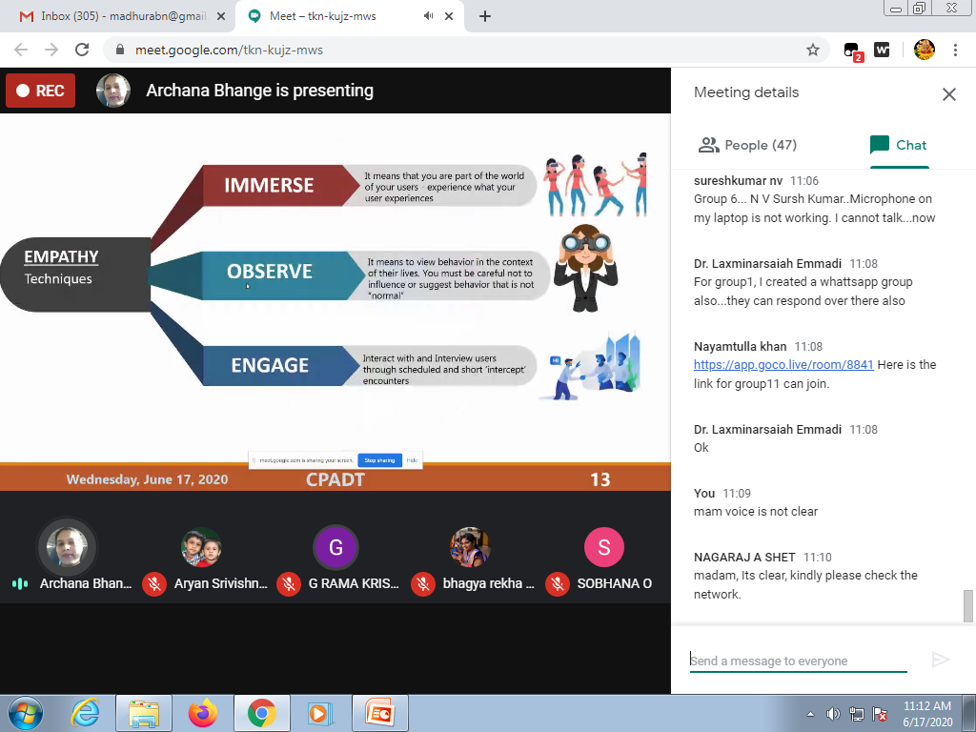

Slide 51
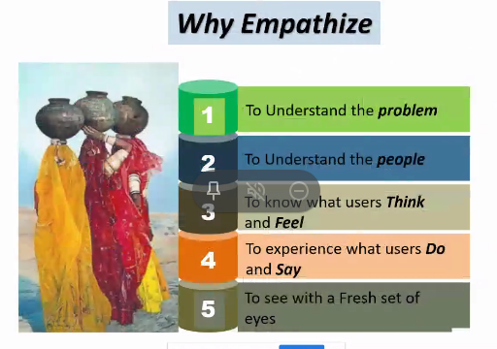

Slide 52
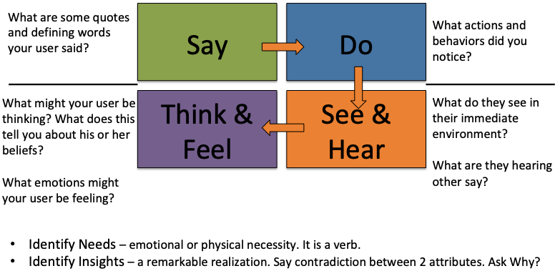
Empathy Map

Slide 53
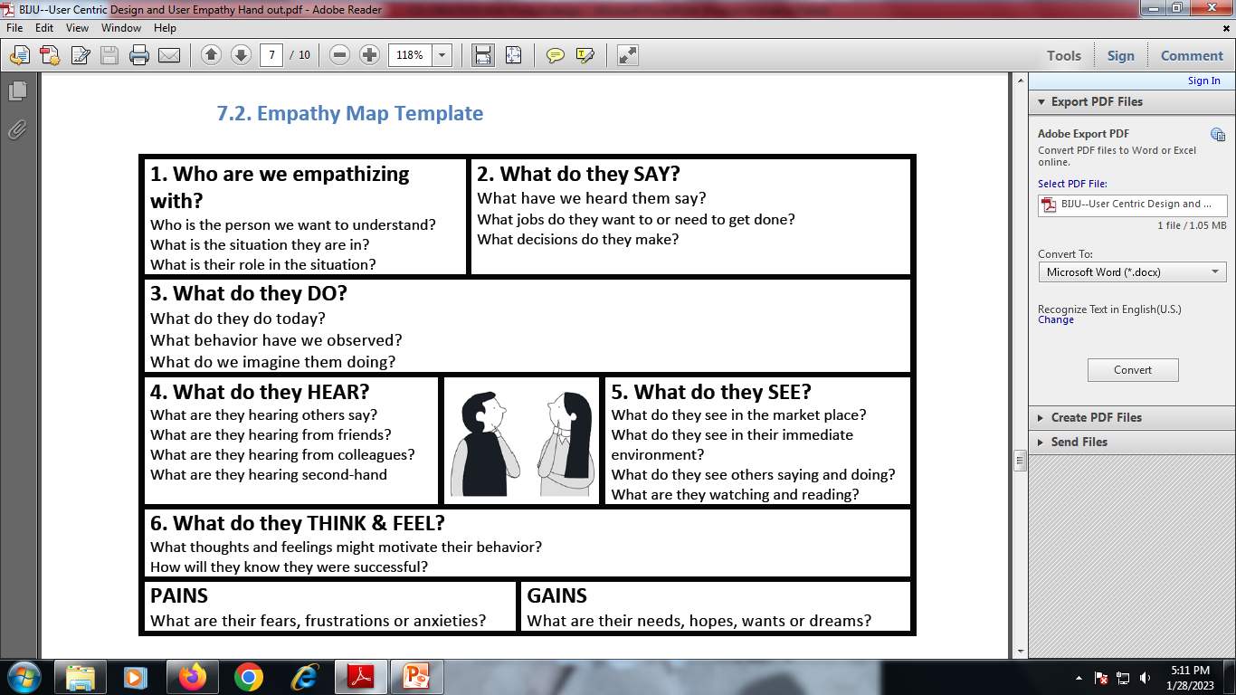

Slide 54
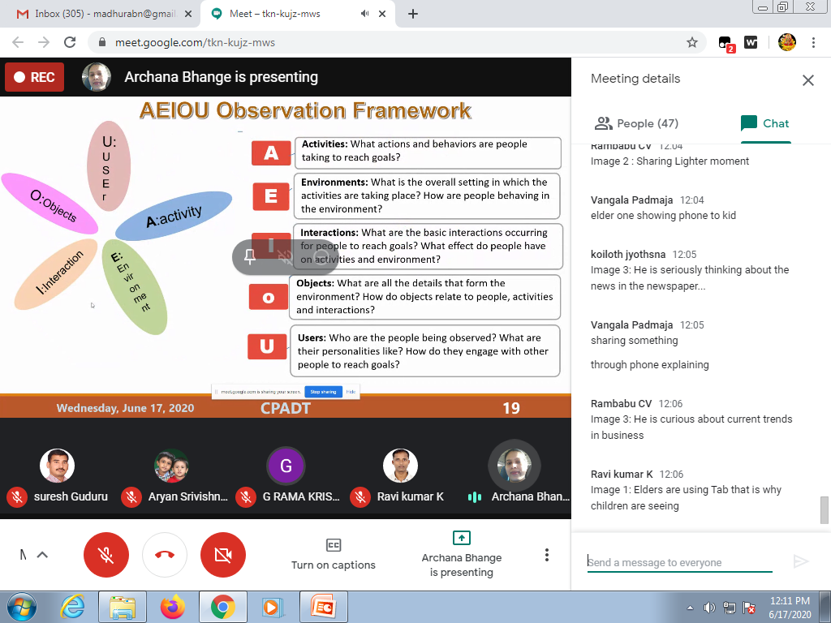

Slide 55
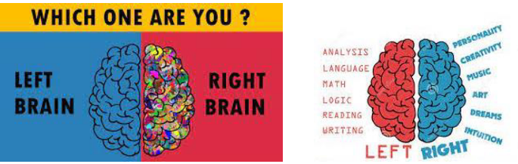
Mind Maps are more convenient than traditional linear notes because • Traditional notes writing is time wasted and energy wasted • Other information may be missed while noting down one idea • It takes longer to read and review • Associations and connections between key words and ideas not readily apparent. • It lacks color and other visual qualities

